Slide 1
Intelligent Agent
Course : COMP6065001 Artificial Intelligence
Effective Period : September 2023
Session 02

Slide 2
Learning Outcomes
At the end of this session, students will be able to:
LO 1: Describe what is AI and identify concept of intelligent agent

Slide 3
Outline
Intelligent Agent
Concept of Rationality
Properties of Environment
Structure of Intelligent Agents

Slide 4
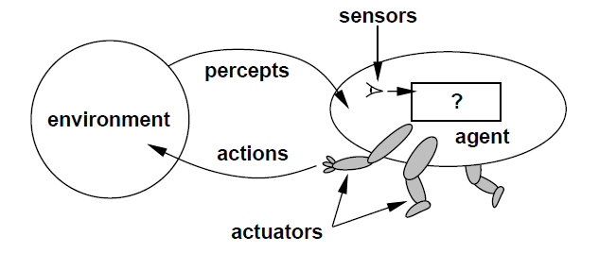
Agent
An agent is anything that can be viewed as perceiving its environment through sensors and acting upon that environment through actuators.

Slide 5
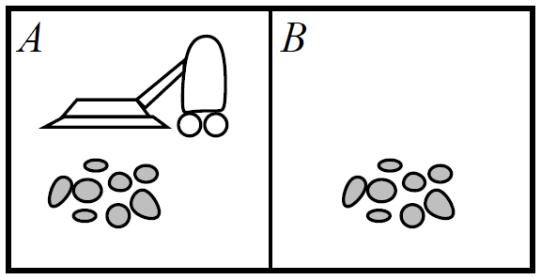
Agent
A vacuum-cleaner world with just two locations
Percept: location and contents, i.e. [A, Dirty]
Actions: Left, Right, Suck, NoOp

Slide 6
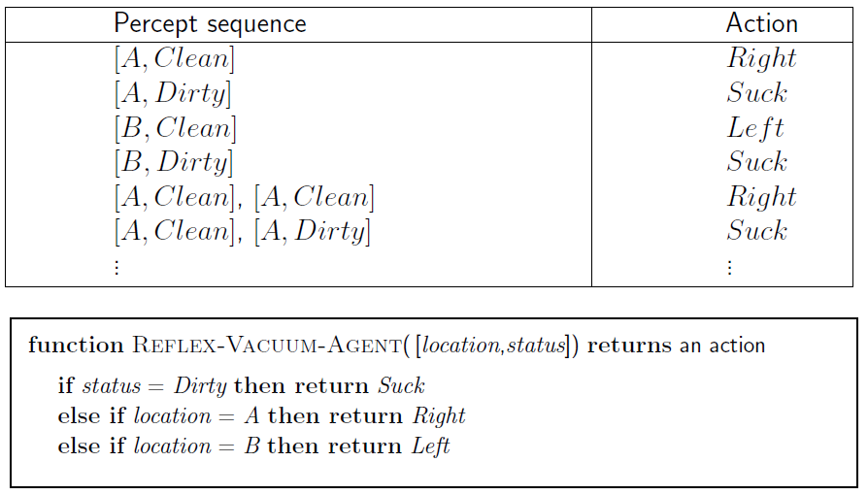
Agent
Partial tabulation of the simple agent function

Slide 7
Concept of Rationality
Definition of a rational agent:
For each possible percept sequence, a rational agent should select an action that is expected to maximize its performance measure, given the evidence provided by the percept sequence and whatever built-in knowledge the agent has.

Slide 8
Task Environments
To build a rational agent, we need to first define the PEAS:
P (Performance)
E (Environment)
A (Actuators)
S (Sensors)

Slide 9
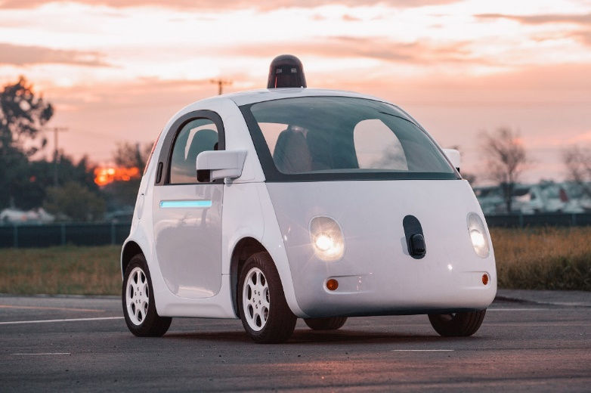
What is PEAS for?
Autonomous car
Performance: safety, destination, legality, comfort
Environment: streets, pedestrian, highway, weather
Actuators: steering, accelerator, brake, horn
Sensors: video, GPS, accelerometer, keyboard
[source]

Slide 10
Structure of Intelligent Agents
Agent = Architecture + Program
Architecture is the hardware
Sensors + Actuators
Program is the software
Program

Slide 11
Agent Types
Four basic type of agents:
Simple reflex agents
Modal-based reflex agents
Goal-based agents
Utility-based agents
All of which can be generalized into learning agents that can improve their performance and generate better actions.

Slide 12
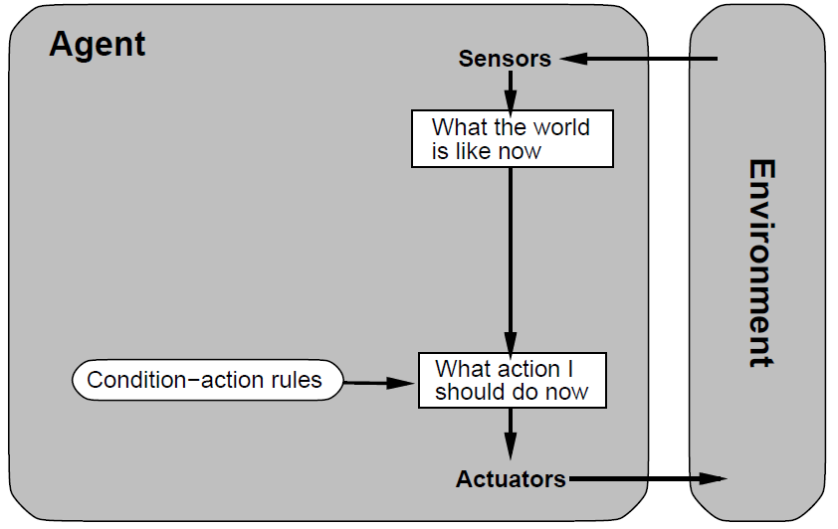
Simple Reflex Agents
An action is done based on the current state only. Ignore the sensors history.

Slide 13
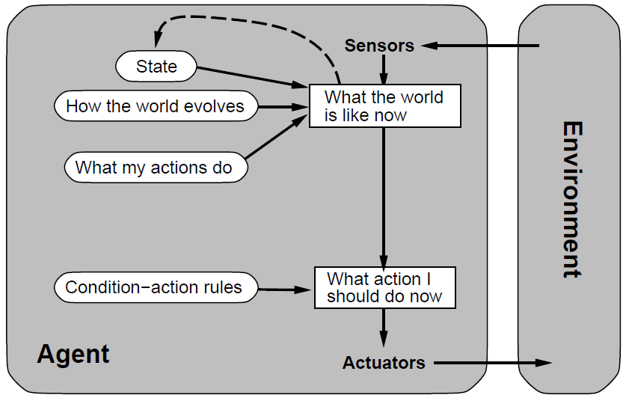
Modal-based Reflex Agents
The sensors and actions history is used to model the world / environment. An action is done based on the world model.

Slide 14
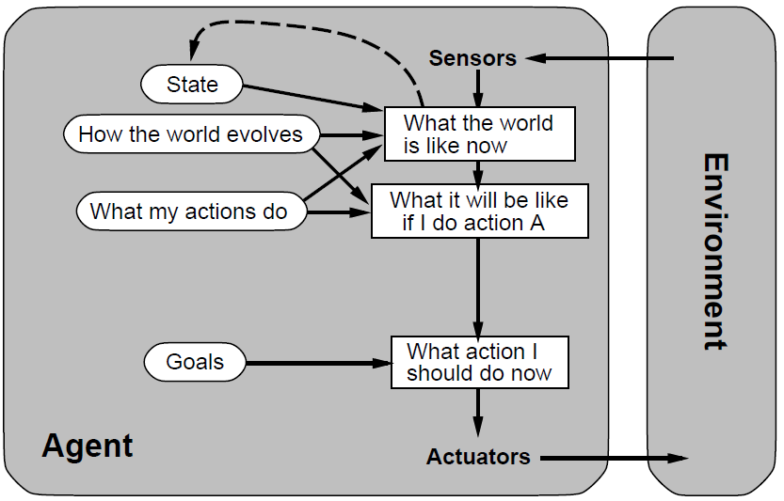
Goals-based Agents
An action is done based on the combined information from the world model and goal information.

Slide 15
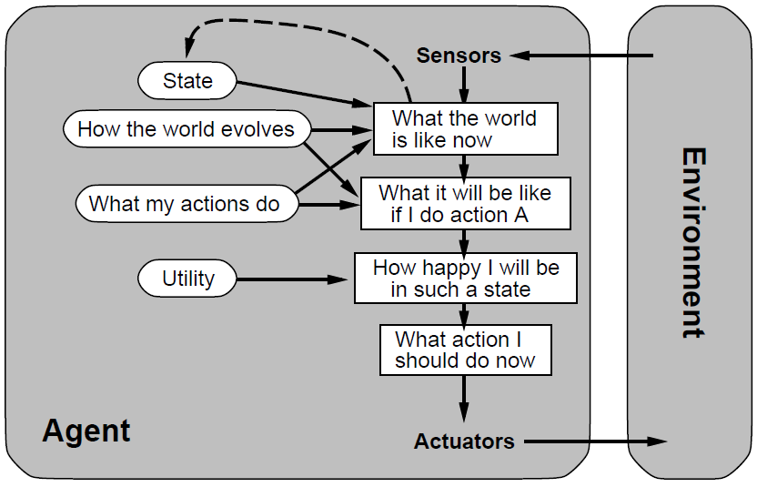
Utility-based Agents
An action is done based on the agent happiness (utility).
It is the agent’s performance measure.

Slide 16
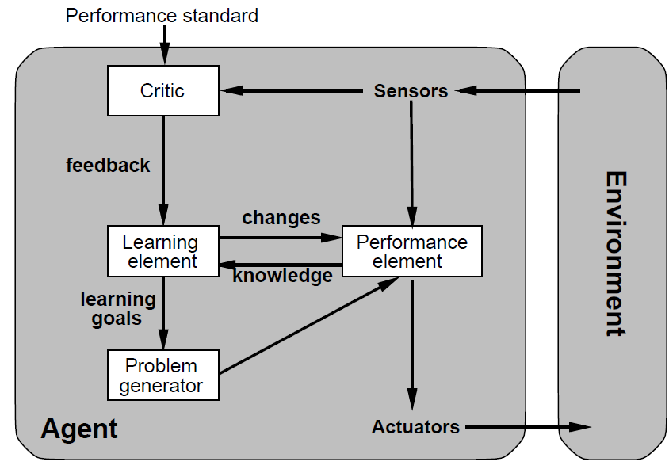
Learning Agents
Programming agents by hand can be very tedious. Some more expeditious method seem desirable" Alan Turing, 1950.

Slide 17
References
Stuart Russell, Peter Norvig. 2010. Artificial Intelligence : A Modern Approach. Pearson Education. New Jersey. ISBN:9780132071482

